Slide 1
Chapter Three
Static Fluid and its Application

Slide 2
What will we learn?
Fluid static
Pressure and pressure gradient
Pressure variation in static fluid
Pressure measurement instrumentations
How to solve manometer problems
References:
Streeter,V. ”Fluid Mechanic”,3rd edition, Mc-Graw Hill, 1962.
Frank M. White “Fluid Mechanics” 5th edition McGraw Hill.
Coulson, J.M. and J.F. Richardson, “Chemical Engineering”, Vol.I “ Fluid Flow, Heat Transfer, and Mass Transfer” 5th edition, (1998).

Slide 3
Static Fluid
Fluid static is a branch of fluid mechanics that deals with fluid at rest with respect to the surface bound them, i.e
no motion of a fluid layer relative to an adjacent layer
no shear stresses in the fluid
When the fluid velocity is zero then the pressure variation is due only to the weight of the fluid and that denoted as the hydrostatic condition.

Slide 4
Pressure and Pressure Gradient
Pressure Force
At a point a fluid at rest has the same pressure in all direction, since there can be no shear shaped particle forces so, the only forces are the normal surface forces and gravity

Slide 5
ΣF_{x} =0 =p_{x}b∆z - p_{n}b∆s sinθ
ΣF_{z} = 0 = p_{z}b∆x - p_{n}b∆s cosθ –(1/2) ρgb∆x∆z
But the geometry of the wedge is such that
∆s sinθ = ∆z and ∆s cosθ = ∆x
Substitution into Eq. (3.1) and rearrangement give
p_{x} = p_{n} p_{z} = p_{n} + (1/2)ρg∆z
Hence:
(1) There is no pressure change in the horizontal direction
(2) there is a vertical change in pressure proportional to the density, gravity, and depth change
the limit as the fluid wedge shrinks to a “point,’’ δz → 0 and above equations become
p_{x} = p_{n} = p_{z} =p

Slide 6
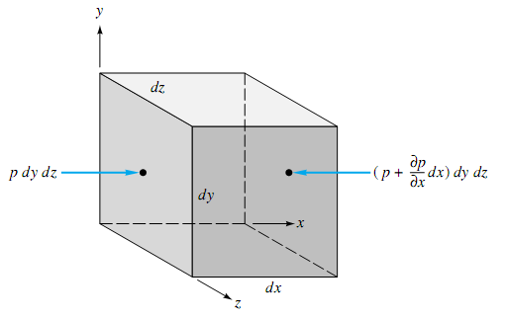


Pressure Gradient
The net force in the x direction on the element
i.e
Thus it is not the pressure but the pressure gradient causing a net force which must be balanced by gravity or acceleration or some other effect in the fluid.

Slide 7
Pressure variation in static fluid
1- Pressure variation in horizontal plane
two points in the same horizontal plane in a contentious mass of fluid at rest have the same pressure.

Slide 8
2 Pressure variation with vertical elevation
P1 = h1 ρ g + Po
P2 = h2 ρ g + Po
P2 – P1 = (h2 – h1) ρ g SI units
P2 – P1 = (h2 – h1) ρ g / gc English units

Slide 9
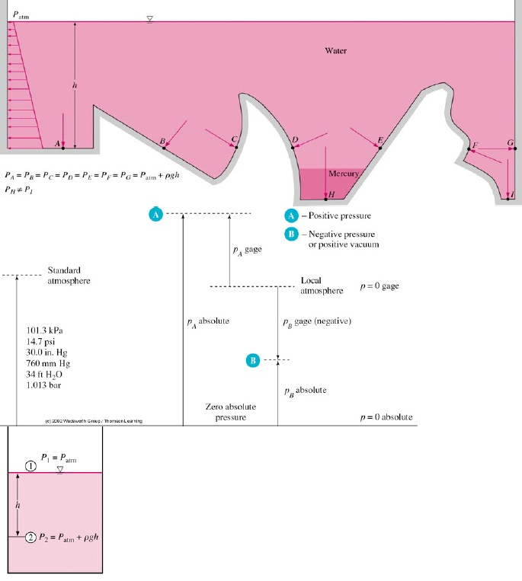
Hydrostatic Pressure Characteristics

Slide 10
Hydrostatic Pressure Characteristics
Pressure in a continuously distributed uniform static fluid varies only with vertical distance and is independent of the shape of the container. The pressure is the same at all points on a given horizontal plane in the fluid. The pressure increases with depth in the fluid.

Slide 11
Gage Pressure and Vacuum Pressure
(1) the absolute or total magnitude
(2) the value relative to the local ambient atmosphere

Slide 12
Atmospheric Pressure
It is the pressure exerted by atmospheric air on the earth due to its weight. This pressure is change as the density of air varies according to the altitudes. Greater the height lesser the density. Also it may vary because of the temperature and humidity of air.
Gauge Pressure or Positive Pressure
It is the pressure recorded by an instrument. This is always above atmospheric.
Vacuum Pressure or Negative Pressure
This pressure is caused either artificially or by flow conditions. The pressure intensity will be less than the atmospheric pressure whenever vacuum is formed.
Absolute Pressure
Absolute pressure is the algebraic sum of atmospheric pressure and gauge pressure.

Slide 13
The measured pressure may be either higher or lower than the local atmosphere, and each case is
given a name:
1. p > pa Gage pressure: p(gage) = p(absolute) - pa
2. p < pa Vacuum pressure: p(vacuum) = pa – p(absolute)

Slide 14
Pressure Measurments
The instrumentation used in pressure measuring may be grouped into four categories:
1. Gravity-based: barometer, manometer, deadweight piston ( it is used most often for calibrations).
2. Elastic deformation: bourdon tube (metal and quartz), diaphragm, bellows,strain-gage, optical beam displacement.
3. Gas behavior: it is mostly special-purpose instruments used for certain scientific experiments like; gas compression (McLeod gage), thermal conductance (Pirani gage),molecular impact (Knudsen gage), ionization, thermal conductivity, air piston.
4. Electric output: resistance (Bridgman wire gage), diffused strain gage, capacita-tive, piezoelectric, magnetic inductance, magnetic reluctance, linear variable differential transformer (LVDT), resonant frequency.

Slide 15
Gravity based measurement
1- Barometer
Barometer: The simplest practical application of the hydrostatic formula is the barometer ,which measures atmospheric pressure. A tube is filled with mercury and inverted while submerged in a reservoir. This causes a near vacuum in the closed upper end because mercury has an extremely small vapor pressure at room temperatures (0.16Pa at 20°C). Since atmospheric pressure forces a mercury column to rise a distance hi nto the tube, the upper mercury surface is at zero pressure.
At sea-level standard,
with pa = 101,350 Pa and
ρg=133,100 N/m³ ,
the barometric height is
h = 101,350/133,100 = 0.761 m
or 761 mm.
Mercury is used because it is
the heaviest common liquid.
A water barometer would
be 34 ft high.
A barometer measures local absolute atmospheric pressure: (a) the height of a mercury column is proportional to p atm; (b) a modern portable barometer, with digital readout, uses the resonating silicon element

Slide 16
2- Anaerobic barometer
It is another device to measure atmospheric pressure in which expansion or contraction in vacuum chamber, caused by change in air pressure, forces the pointer to move.
3- Manometers
I t is a simple and inexpensive hydrostaticprinciple device with no moving parts except the liquid column itself. Manometer measurements must not disturb the flow.
A manometer is a device for measuring fluid pressure consisting of a bent tube containing one or more liquids of different densities
In manometer a known pressure (which may be atmospheric) is applied to one end of the manometer tube and the unknown pressure (to be determined) is applied to the other end
The Differential pressure manometers measure only the difference between the two pressures
There are many types of manometer:
Simple manometer – Piezometer
Simple U – tube manometer
Inverted U – tube manometer
U - tube with one leg enlarged (Well type manometer)
Two fluid U – tube manometer
Four-fluid U – tube manometer
Inclined U – tube manometer
Accurate manometer

Slide 17
3-1 Simple manometer – Piezometer
It’s used to measure pressure in a static fluid by using the height of
a column of liquid
pressure at point 1 = pressure at point 2
= pressure at point A
P₁ = P_{A}+ ρgh
3-2 Simple U – tube manometer
It is used to measures the pressure at a point and consists of bent tube glass with one end exposed to atmosphere and the other attached to the fluid being measured(figure 3-9)
PG= Patm+ ρLgh – ρGg(h+h,,)
≈ Patm+ ρLgh since ρL>>>ρG
3-3 Differential U – tube manometer
It is used when difference between two pressures needed and consists of
a transparent U-tube containing the fluid of density (ρ) whose pressure is to be measured and a
n immiscible fluid (m) of higher density (ρm).
The limbs are connected to the two points between which the pressure difference (P2 - P1) is required
The pressure at level x will be: P_{x} = P₁ + ρg (a+h)
The pressure at level x’ will be: P_{x’} = P₂ + ρ_{m} g h + ρ g a
Since P_{x} = P_{x’} ( at same level)
Then P₁ – P₂ = (ρ_{m} – ρ ) gh
There is other type of differential U – tube manometer
The configuration A suitable for large pressure
differences and requires dense measuring fluid
(e.g. mercury), while configuration B for small
differences and needs light measuring fluid

Slide 18
3-4 Inverted U- Tube manometer
It is used for measuring pressure differences in liquids. The space above the liquid in the manometer is filled with air, which can be admitted or expelled through the tap A in order to adjust the level of the liquid in the manometer.(figure 3-13)
The pressure at level x will be: P_{x} = P₁ - ρg (a+h)
The pressure at level x’ will be: P₂ - ρ_{m} g h - ρ g a
Since P_{x} = P_{x’} ( at same level)
Then P₁ – P₂ = (ρ - ρ_{m}) gh
3-5 U - tube with one leg enlarged (Well type manometer)
It is used to measure low pressures, where accuracy id of much importance.
The pressure difference is : ∆P = P₁ –P­₂ = (ρ_{m} - ρ)hg
3-6 The inclined manometer
It enables the sensitivity of the manometers described previously to be increased by measuring the length of the column of liquid. If θ is the angle of inclination of the manometer (typically about 10-20°) and L is the movement of the column of liquid along the limb, then:
hm = L sin θ
If θ = 10°, the manometer reading L is increased by about 5.7 times compared
with the reading hm which would have been obtained from a simple manometer.

Slide 19
3-7 Two fluid U – tube manometer
It is used for small pressure differences or accurate determination of large
pressure difference ΔH occurs due to the pressure difference
between 1, 2
Let p1 > p2 but small difference
pa = pb
using
3-8 Four-fluid U – tube manometer

Slide 20
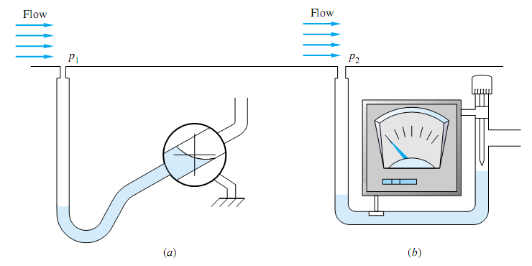
3-9 Accurate manometer
Two types of accurate manometers for precise measurements: (a) tilted tube with eyepiece; (b) micrometer pointer with ammeter detector.

Slide 21
Elastic Deformation Instrument
Whenever a very high fluid pressure is to be measured, and a very great sensitivity gauge is best suited for these purposes. They are also designed to read vacuum pressure. It is also used for measurement of pressure in boilers or other pipes, where tube manometer cannot be conveniently used.
1- The Bourdon gauge
The pressure to be measured is applied to a curved tube, oval in cross-section, and the deflection of the end of the tube is communicated through a system of levers to a recording needle. This gauge is widely used for steam and compressed gases, and frequently forms the indicating element on flow controllers.

Slide 22
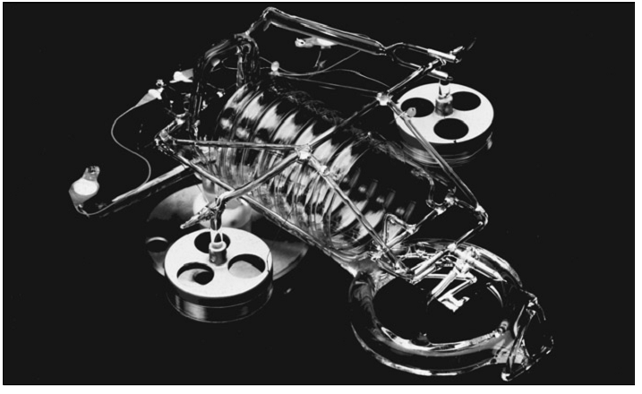
2- Fused Quartiz bourdon
It is one of the most accurate pressure sensors ever devised, with uncertainty of the order of 0.003 percent. Its deflection is sensed optically and returned to a zero reference state by a magnetic element whose output is proportional to the fluid pressure.

Slide 23
How to solve manometer problems?
In general, follow the following steps when analyzing manometry problems:
1. On manometer schematic, label points on each end of manometer and each
intermediate point where there is a fluid-fluid interface: e.g., A – 1 – 2 - B
2. Express overall manometer pressure difference in terms of appropriate
intermediate pressure differences.
PA - PB = (PA- P1) + (P1 – P2) + (P2 - PB )
3. Express each intermediate pressure difference in terms of appropriate
product of specific weight * elevation change (watch signs)
PA- PB = - ρ g(zA- z1) – ρ g (z1 – z2) – ρ g (z2 - zB )
4. Substitute for known values and solve for remaining unknowns.
When developing a solution for manometer problems, take care to:
1. Include all pressure changes
2. Use correct ∆Z and γ with each fluid
3. Use correct signs with ∆ Z. If pressure difference is expressed as
PA – P1, the elevation change should be written as ZA – Z1
4. Watch units.

Slide 24
Example 1
Given the indicated manometer, determine the gage pressure at A.
Given that Pa =101.3 kPa and the fluid at A is Meriam red oil no. 3.
ρgw = 9790 N/m³
ρg A = S.G.*ρgw = 0.83*9790 N/m³
ρg A = 8126 N/m³
ρgair = 11.8 N/m³
Example 2
Pressure gage B is to measure the pressure at point A in a water flow.
If the pressure at B is 87kPa, estimate the pressure at A,
in kPa. Assume all fluids are at 20°C.
Example 3
The following Figure shows a manometer connected to the pipeline
containing oil of sp.gr. 0.8. Determine the absolute pressure of the
oil in the pipe, and the gauge pressure.

Slide 25
Example 4
A differential manometer is connected to two pipes
as shown in Figure. The pipe A is containing carbon
tetrachloride sp.gr. = 1.594 and the pipe B is contain an
oil of sp.gr. = 0.8. Find the difference of mercury level if
the pressure difference in the two pipes be 0.8 kg/cm2.
Example 5
Water flows downward in a pipe at 45°, as shown in Fig.. The pressure drop p1 _ p2 is partly due to gravity and partly due to friction. The mercury manometer reads a 6-in height difference. What is the total pressure drop p1 - p2 in lbf/in2?

Slide 26
Example 6
A closed vessel is divided into two compartments. These compartments contain oil and water as shown in Figure. Determine the value of (h).
Example 7
In the following both the tank and the tube are open to the
atmosphere. If L = 2.13 m, what is the angle of tilt θ of
the tube?

