Slide 1
ادارة المراجع للبحوث والاطاريح باستخدام برنامج حاسوبي Management of References for Articles and Theses via a Computer Program
Dr. Saad B. H. Farid
Department of Materials Engineering
University of Technology
June, 2016

Slide 2
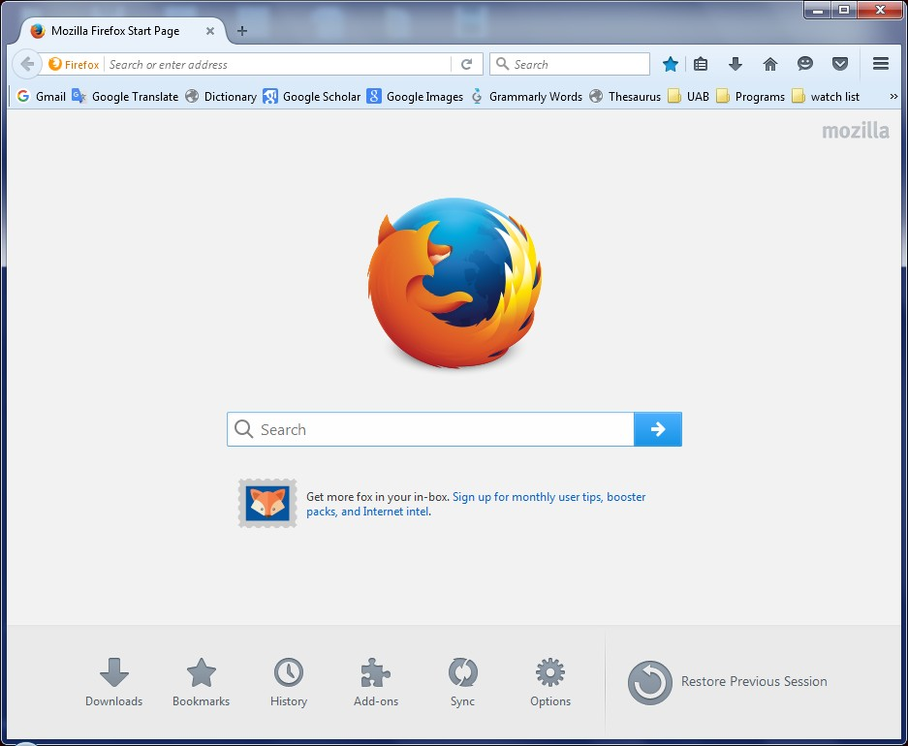

Slide 3
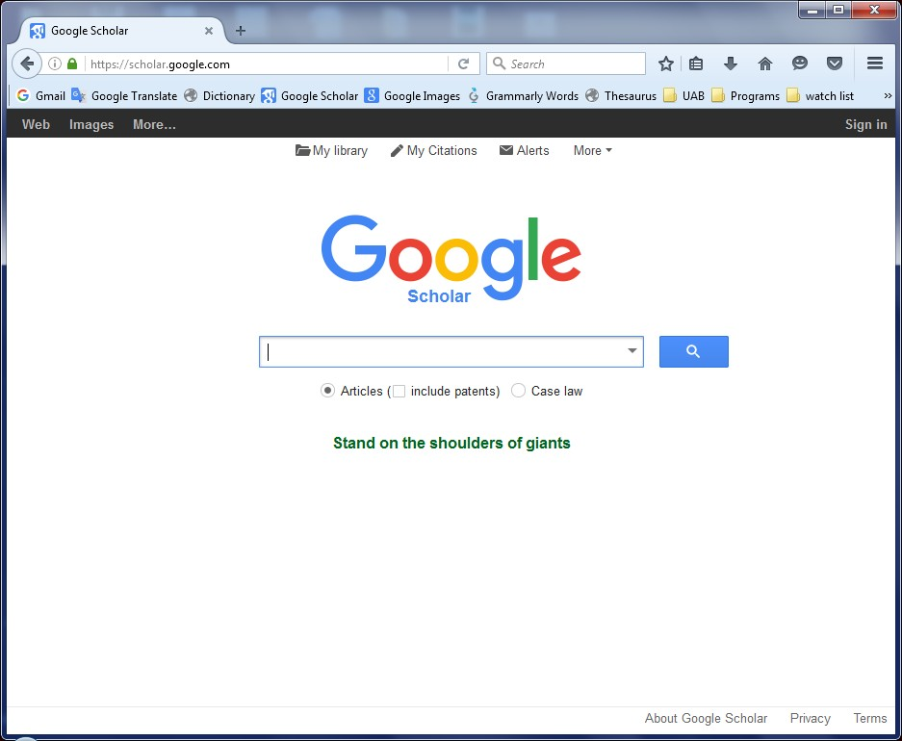
https://scholar.google.com/

Slide 4
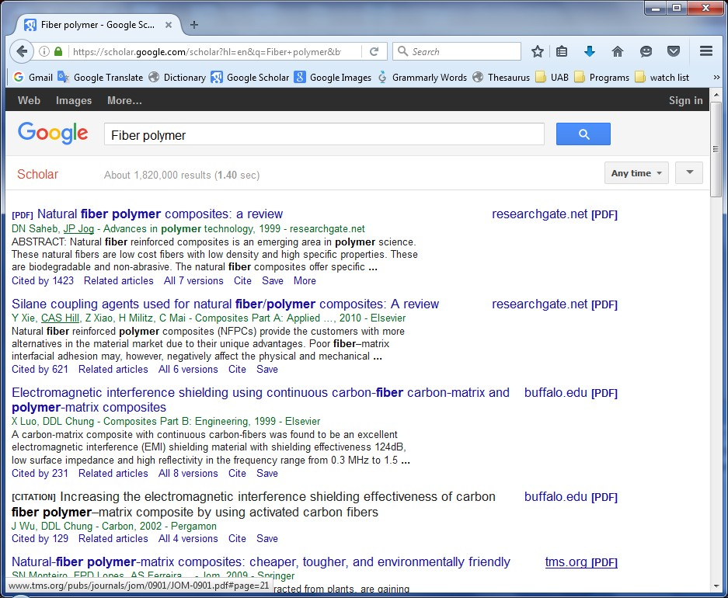
Fiber Polymer

Slide 5
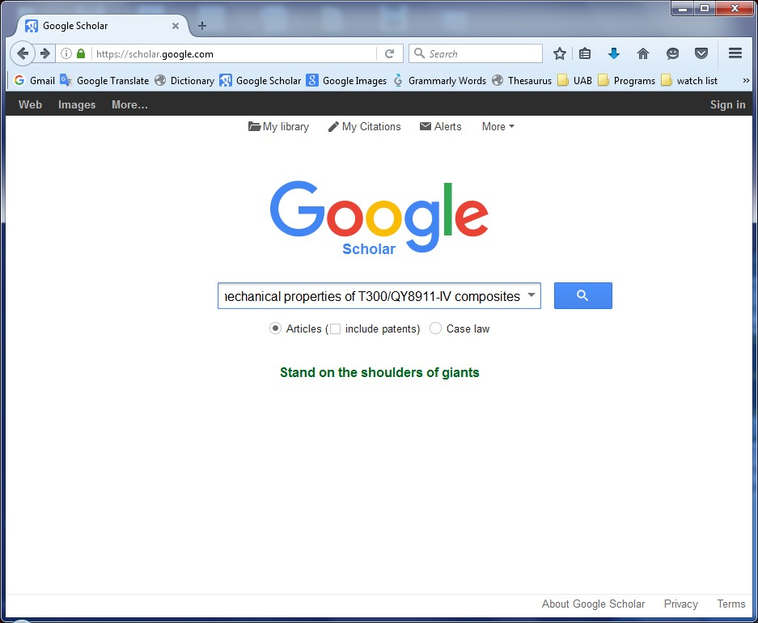
Effects of temperature and fiber volume fraction on mechanical properties of T300/QY8911-IV composites

Slide 6
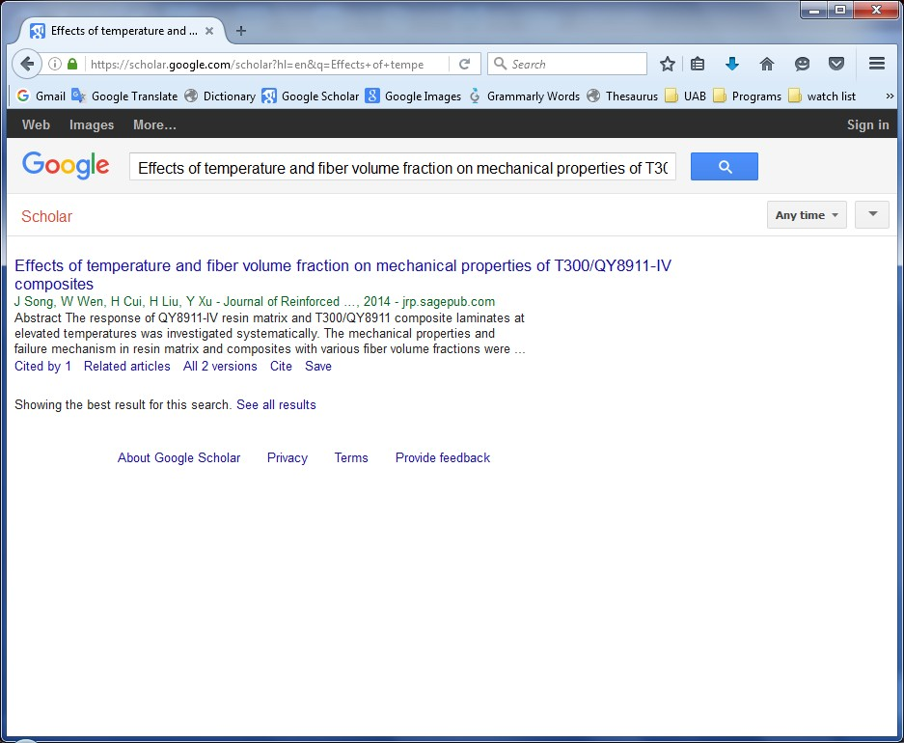
Cite
Or
More → Cite

Slide 7
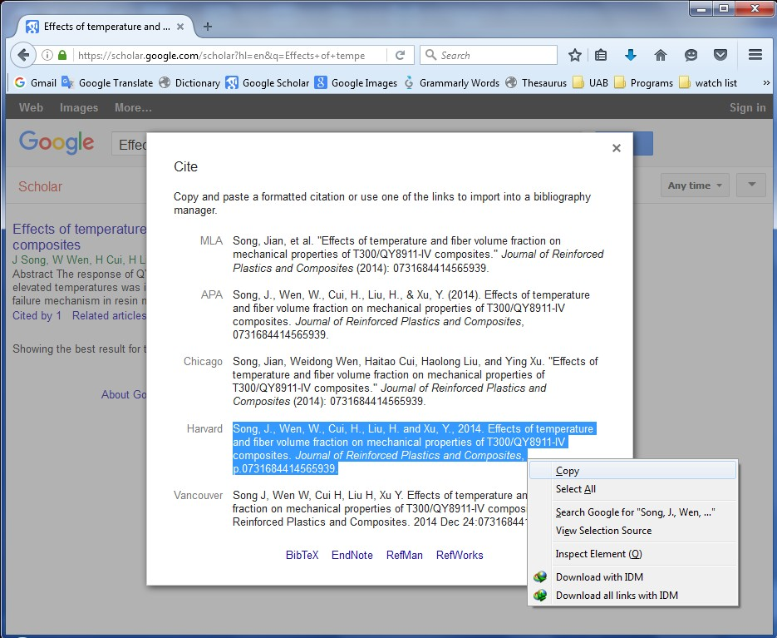

Slide 8
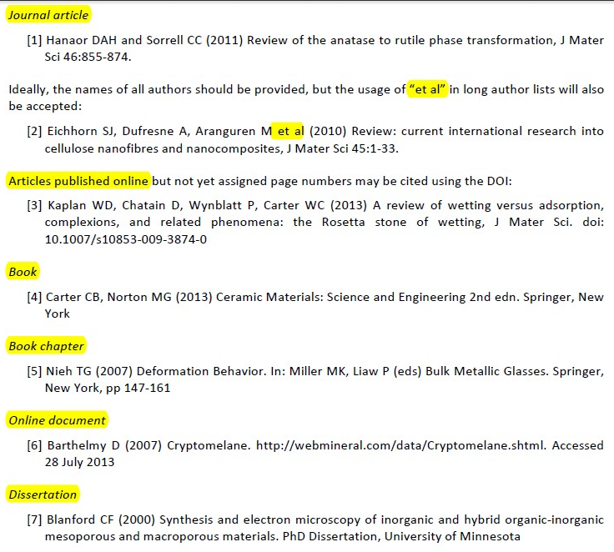
Ceramics International
Journal of Materials Science
The problem is the complication of the styles. Specially when going to other journal

Slide 9
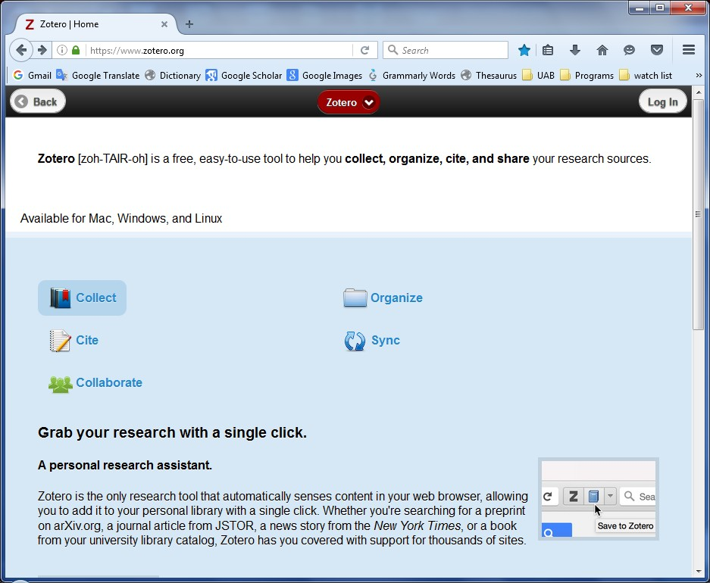
1- https://www.zotero.org/
2- Log In

Slide 10
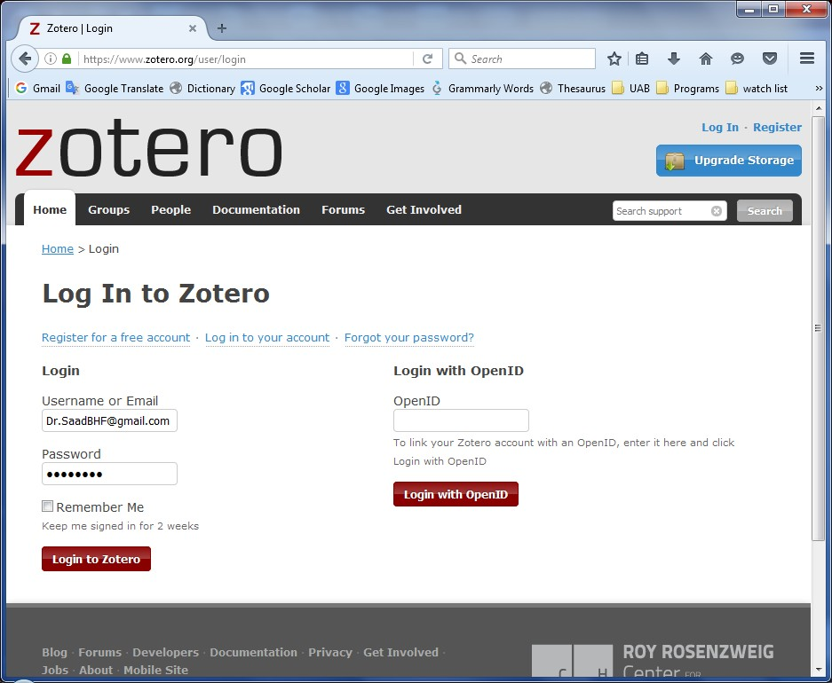
Register for a free account
Log in to your account
Forgot your password?

Slide 11
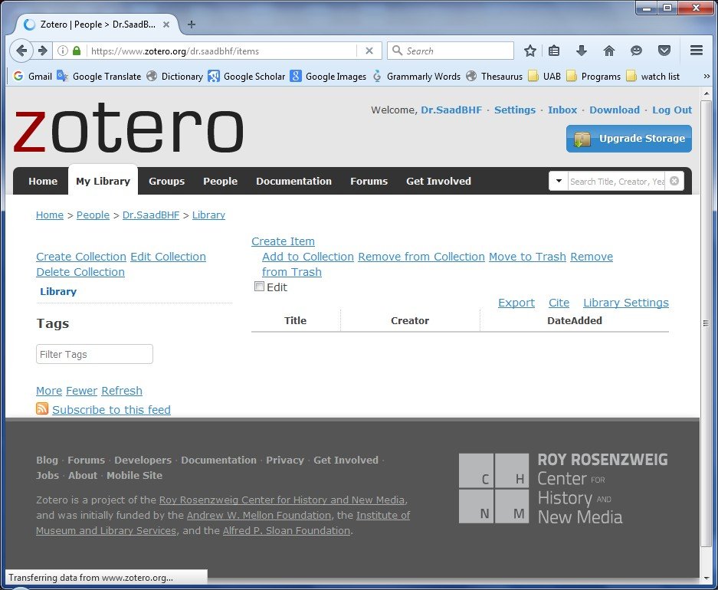
Download

Slide 12
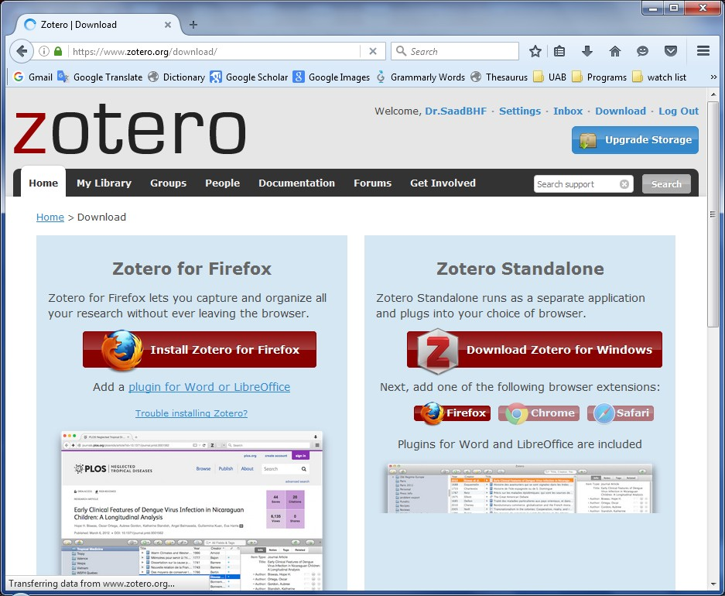

Slide 13
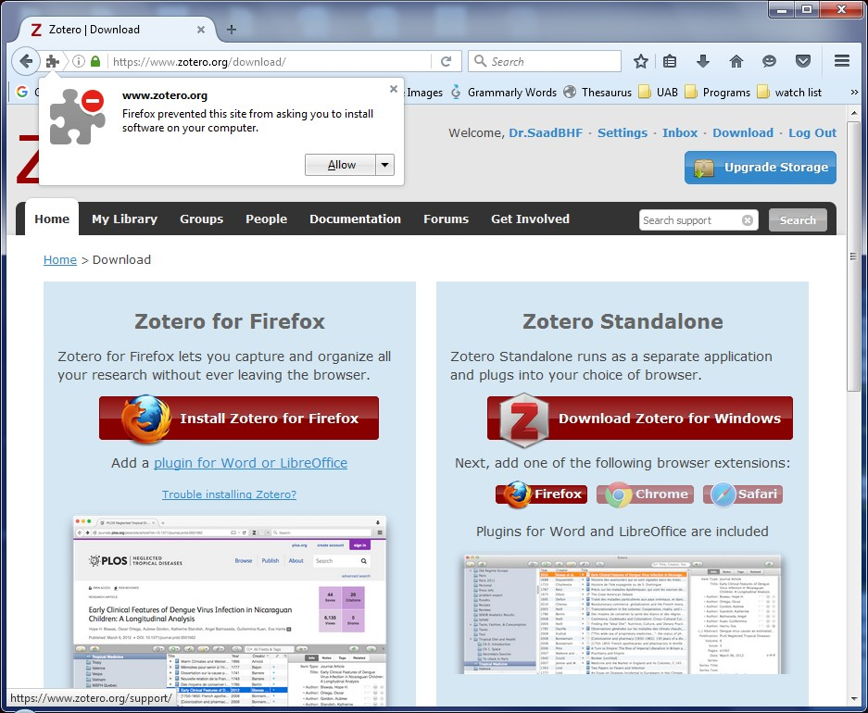
Allow

Slide 14
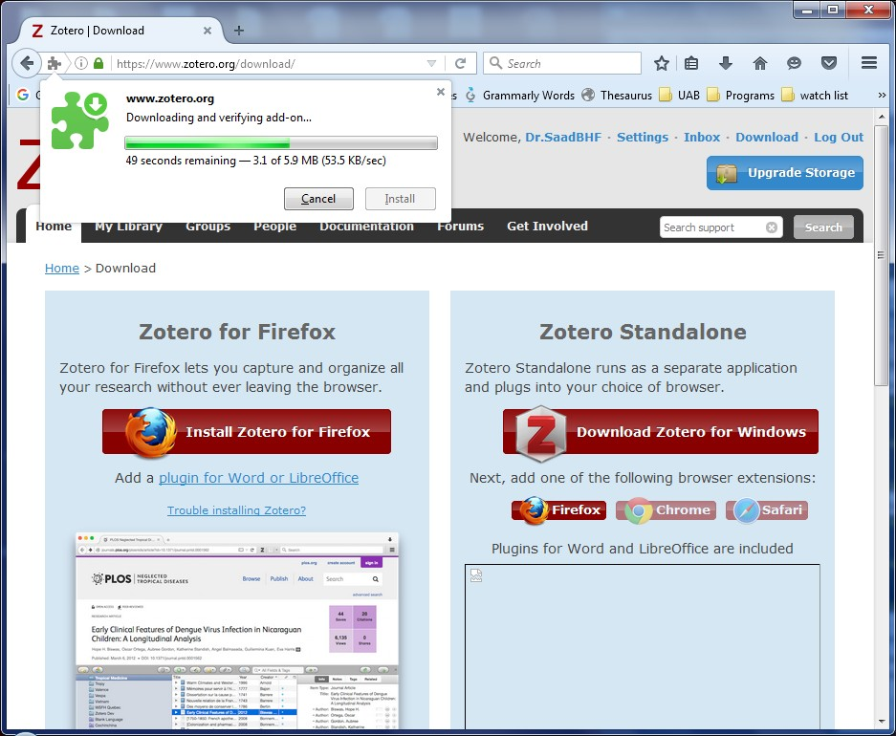
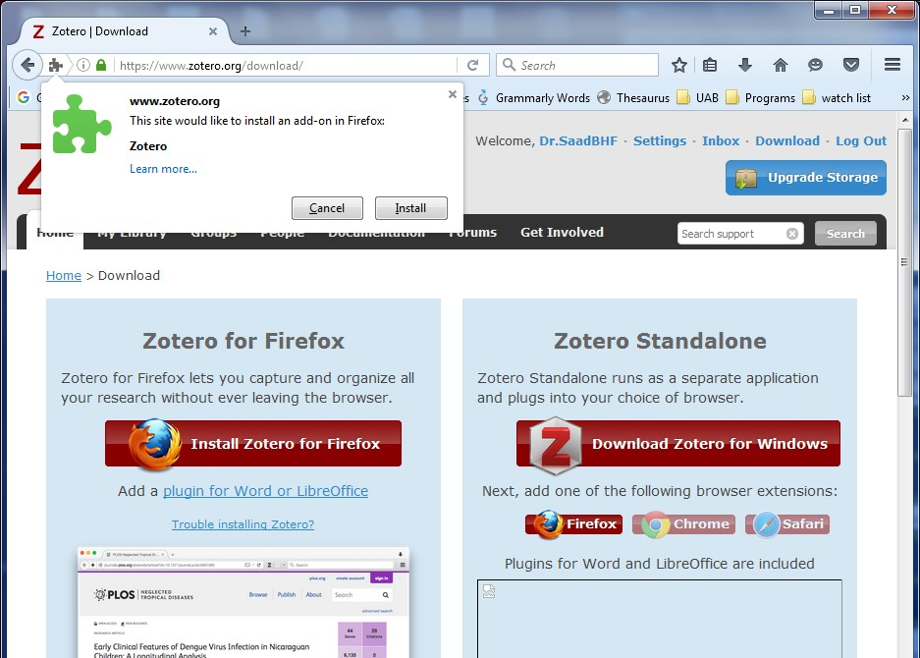
1- Progress Indicator
2- Install
3- Restart Now

Slide 15
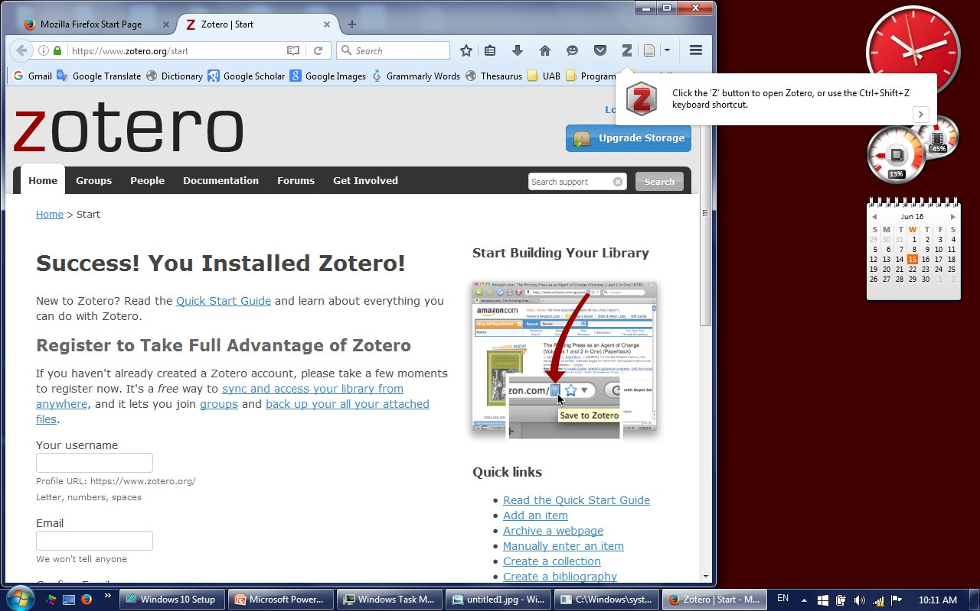
Zotero Icon

Slide 16
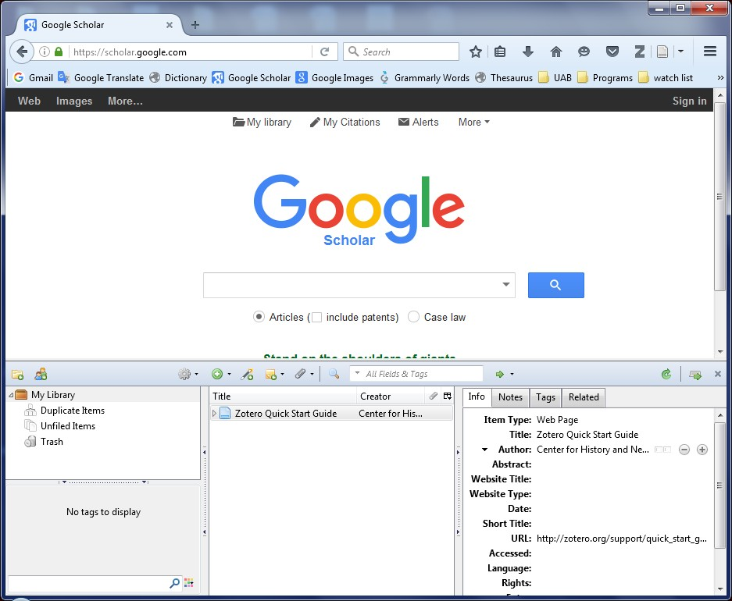
1- Zotero Icon
2- Toggle Tab Mode

Slide 17
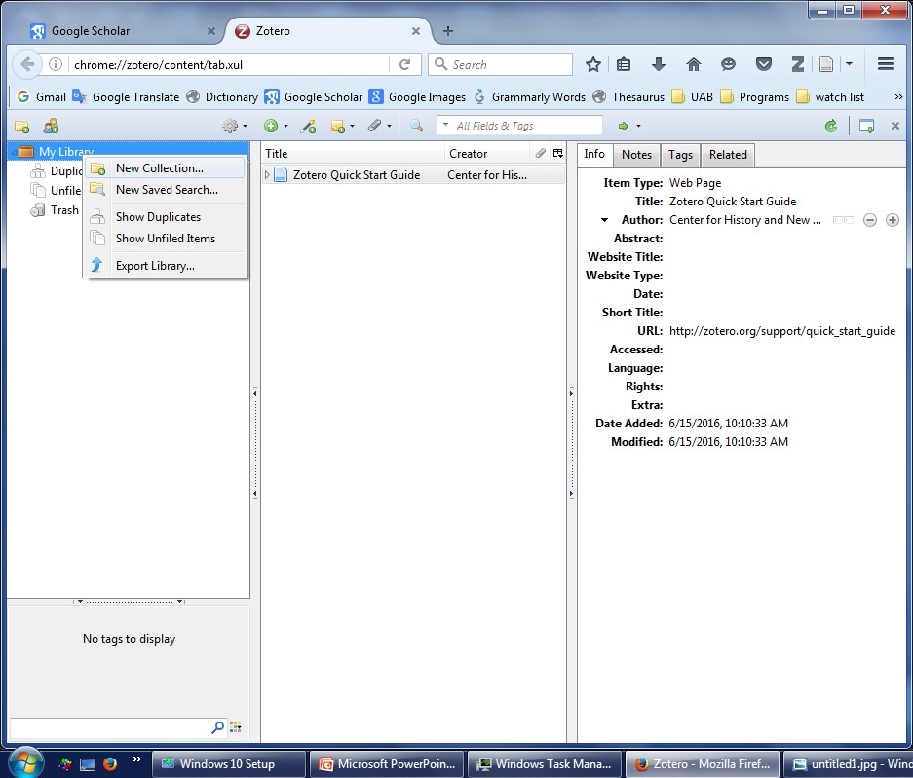
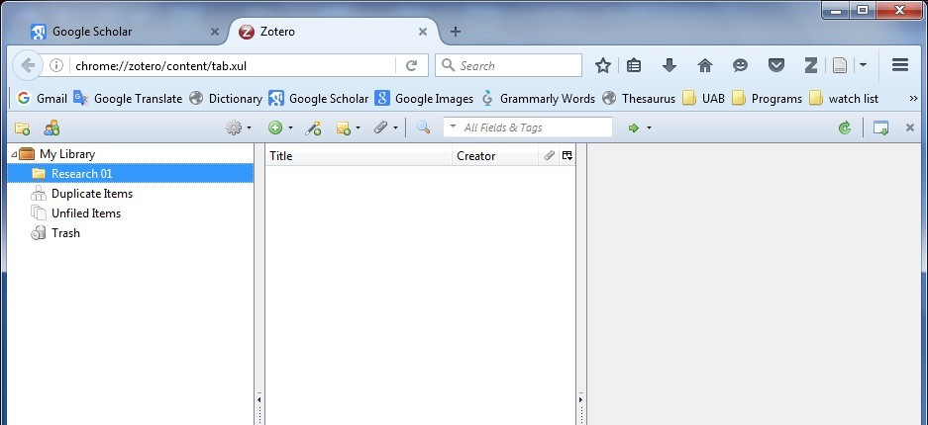
1- New Collection
Toggle Tab Mode
2- Research 01
3- Folder name "Research 01"

Slide 18
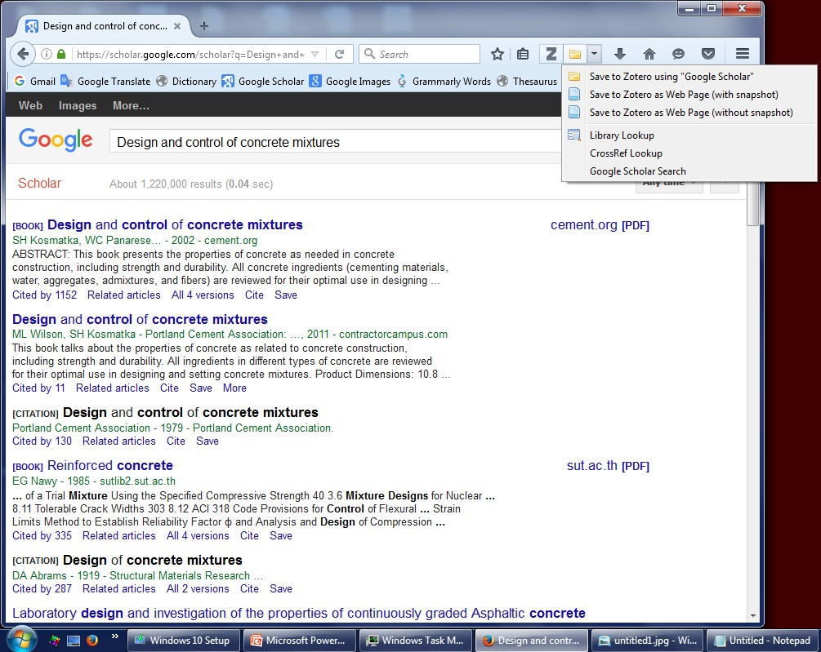
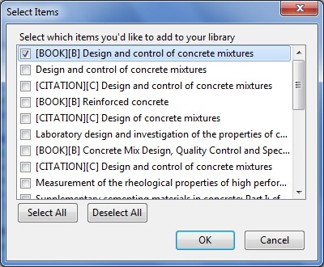
Save to Zotero Using "Google Scholar"

Slide 19
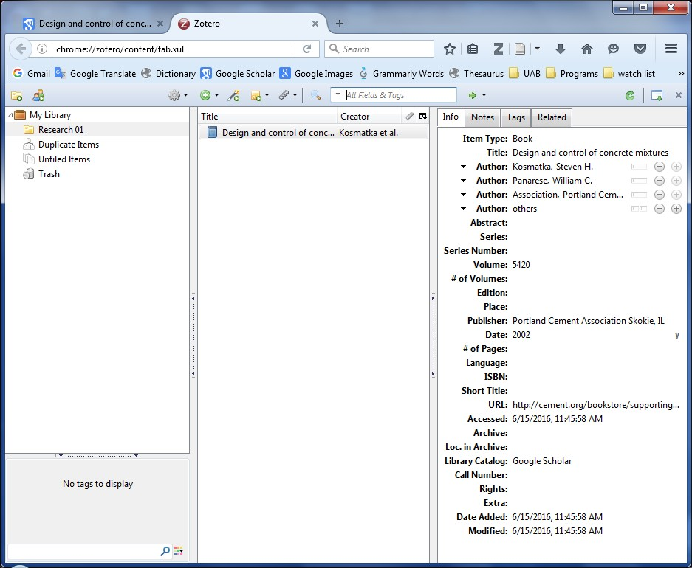
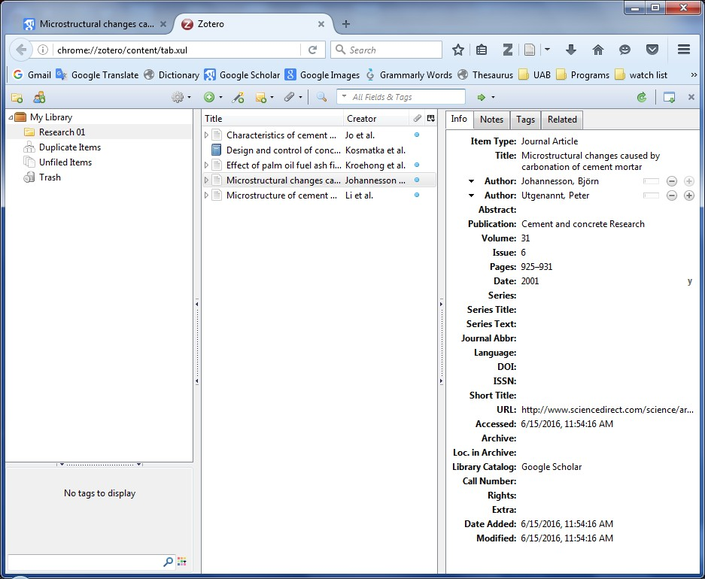

Slide 20
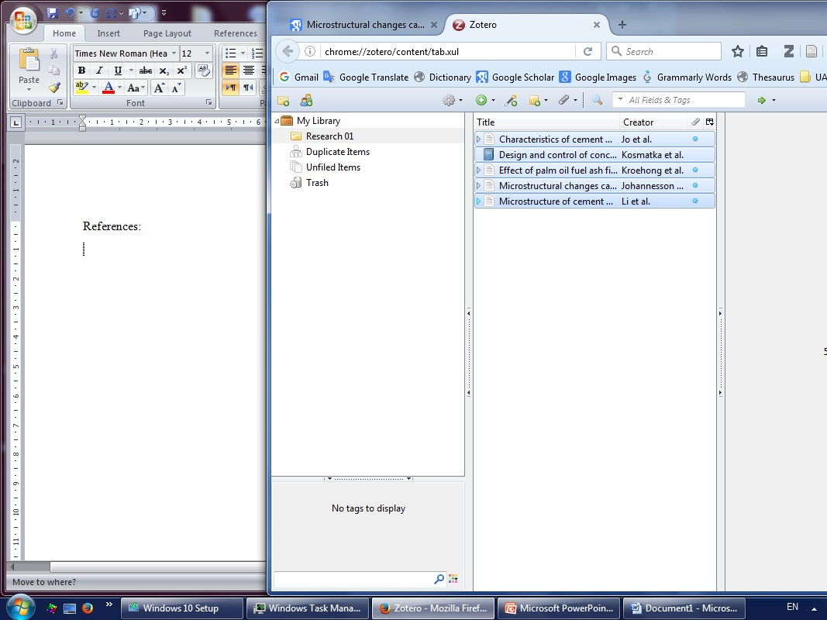
1- Select All by CTRL+A
Select and de-Select by CTRL+Click
2- Drag and Drop to the MS-word document

Slide 21
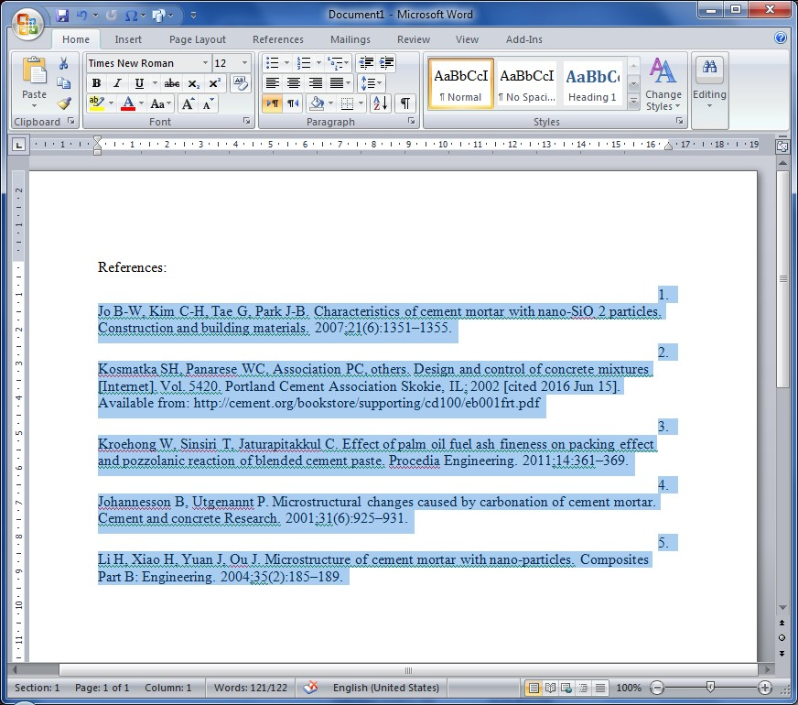
Align Left
Style name: Vancouver

Slide 22
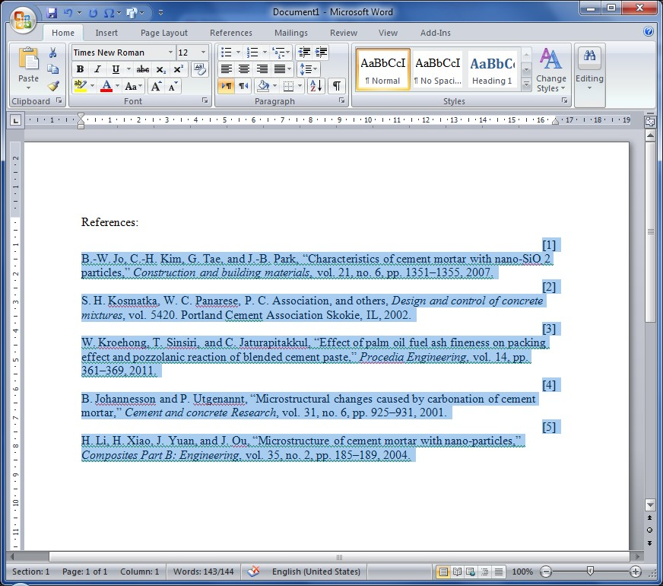
Align Left
Style name: IEEE

Slide 23
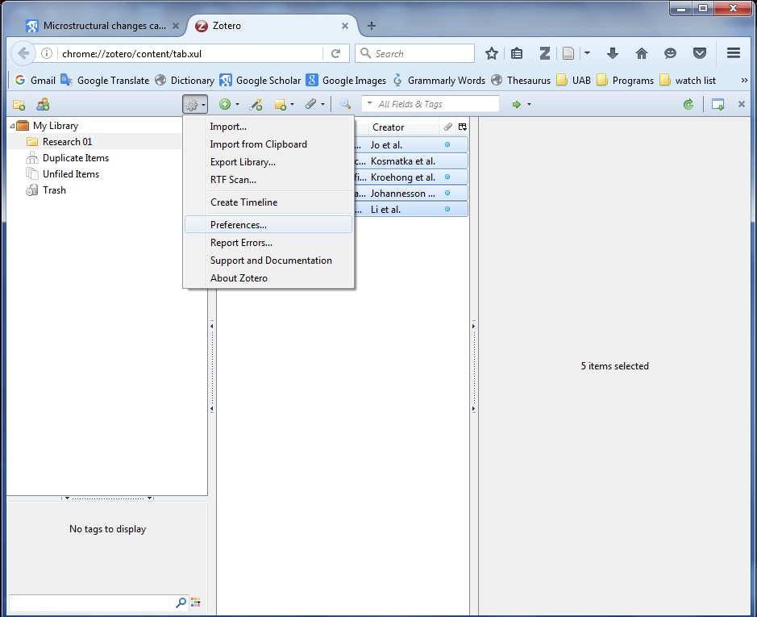
How to change Style (different journal):
Setting wheel→ Preferences

Slide 24
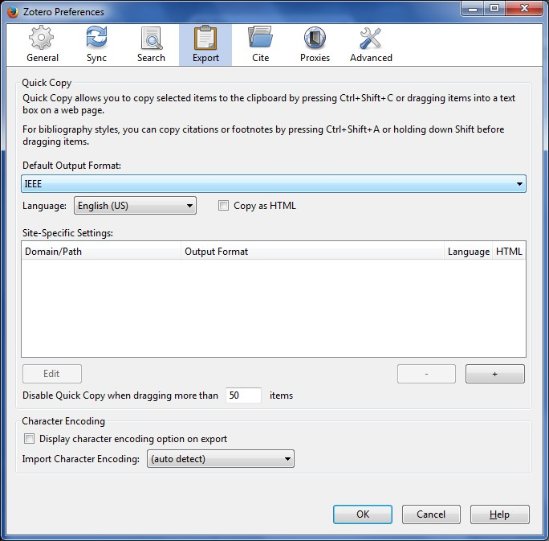
Export: Drop List to choose style
Cite: to import new Style

Slide 25
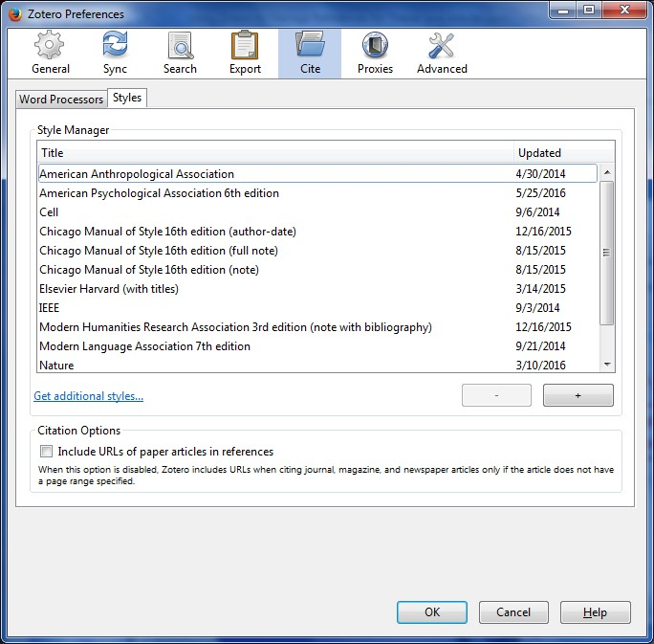
1- Cite → Styles
2- Get additional Styles

Slide 26
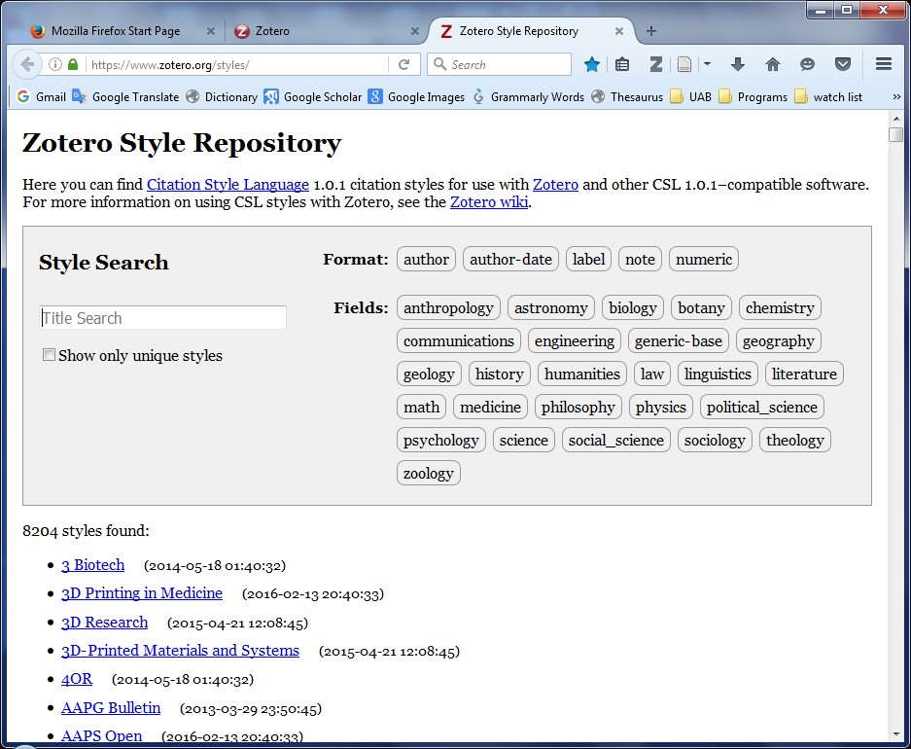
Next:
Type the journal name

Slide 27
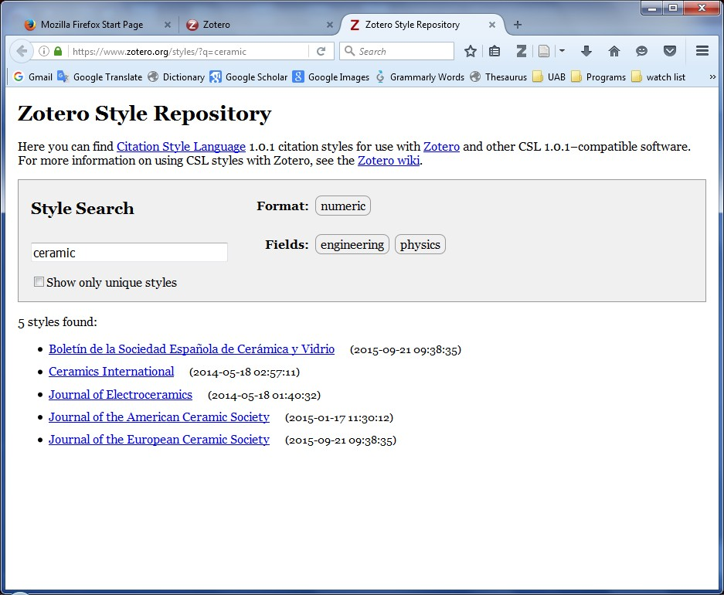
1- The search is limited
2- Choose e.g. Ceramics International

Slide 28
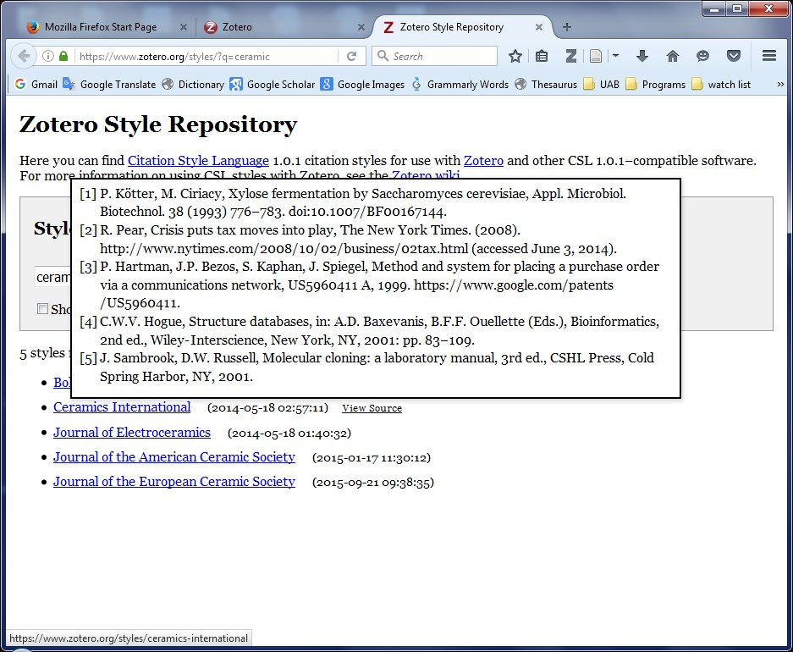
Mouse over → Preview
Next: click on the Journal name

Slide 29
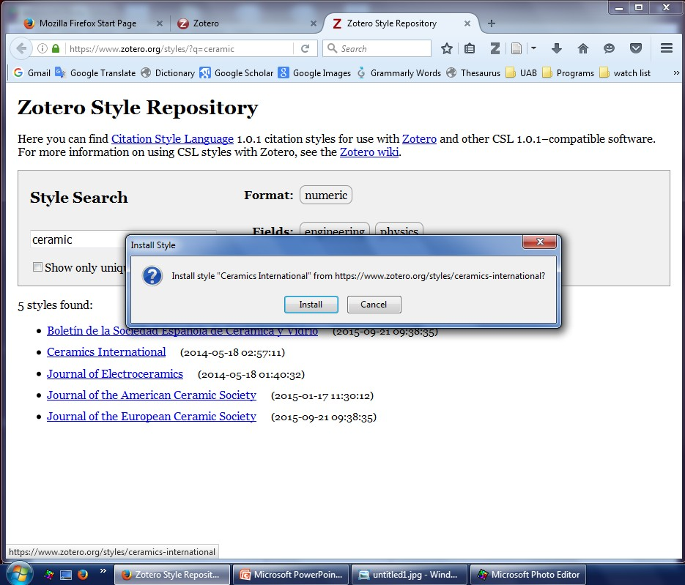
Install Style →
Click on Install

Slide 30
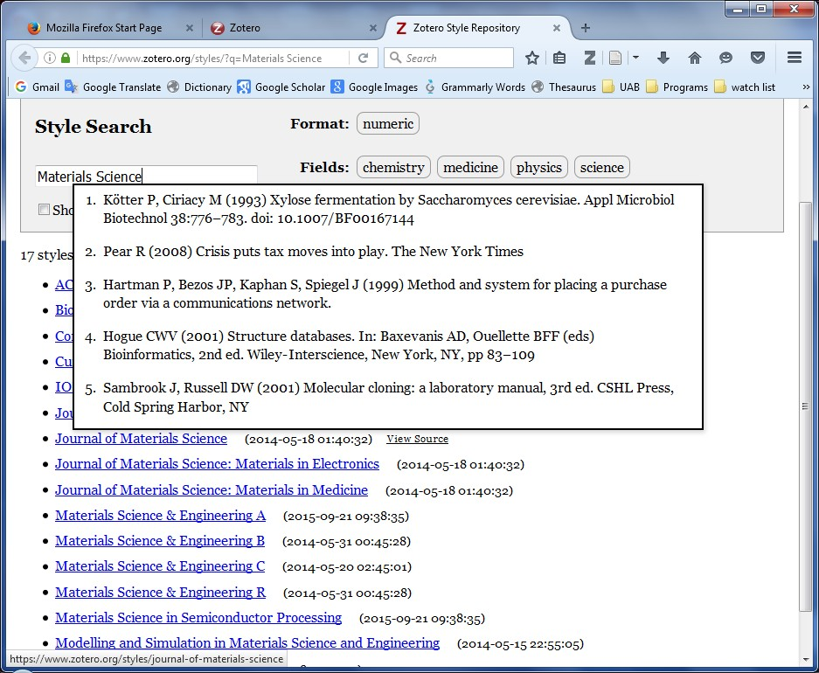
Journal of Materials Science
Different Style
Then install

Slide 31
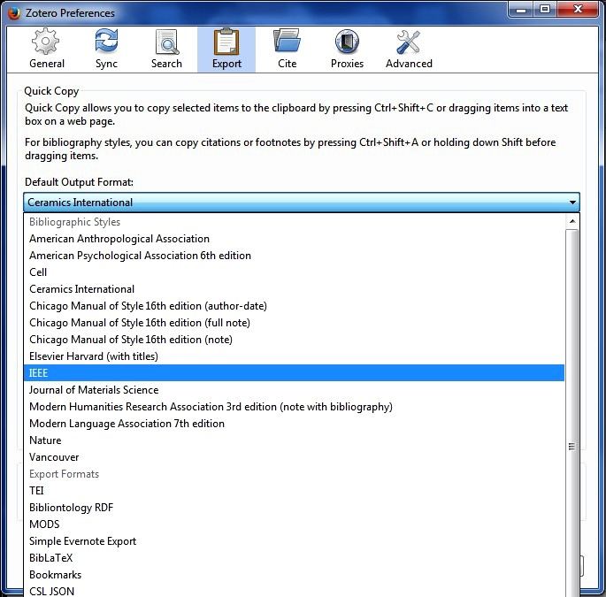
Again: Setting wheel→ Preferences → Export
Select e.g. Ceramics International, then OK

Slide 32
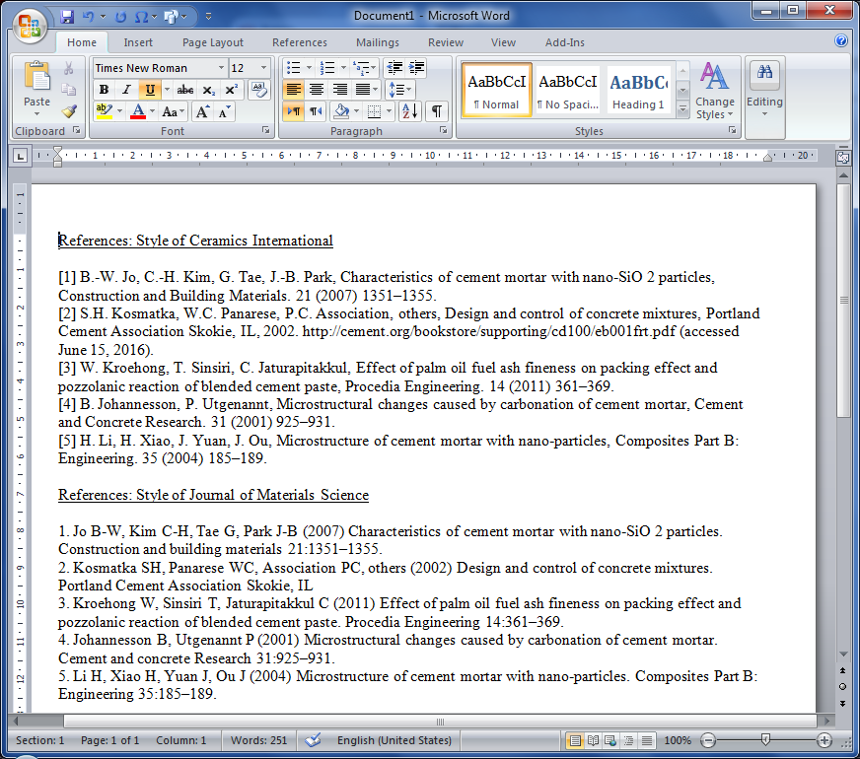

Slide 33
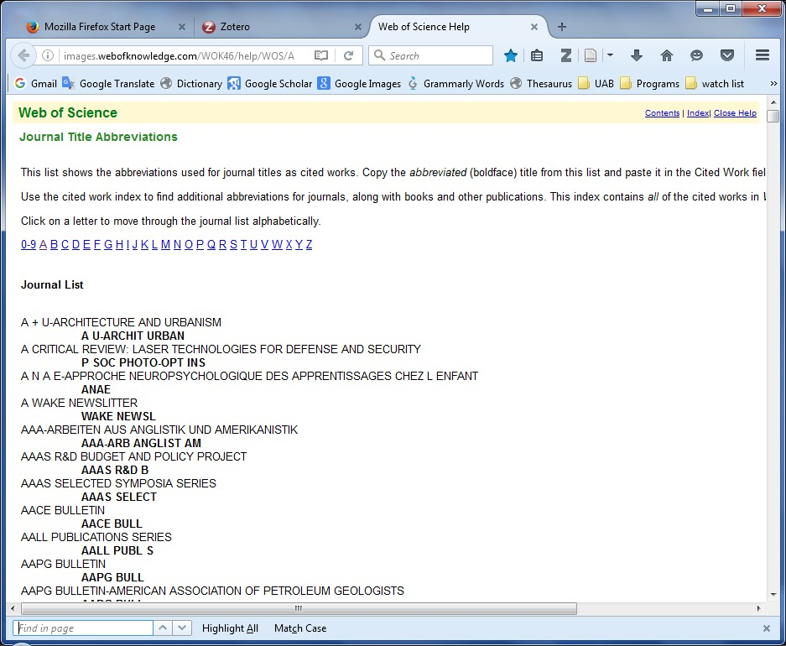
To find journal abbriviations:
1- go to the “Web of Science”
http://images.webofknowledge.com/WOK46/help/WOS/A_abrvjt.html
Or google “Web of Science”
2- CTRL+F to find the journal

Slide 34
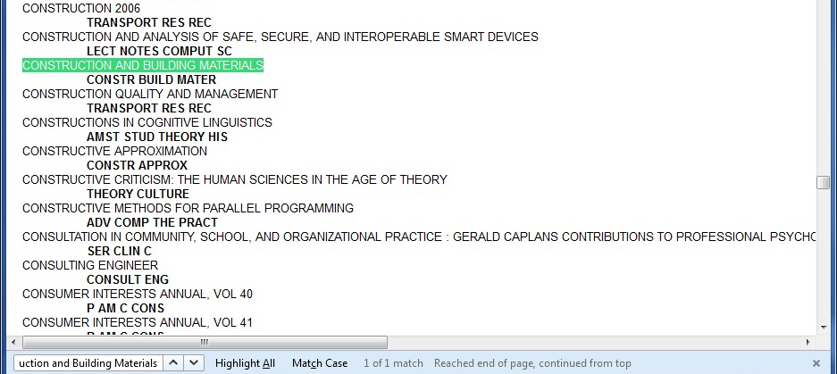
1- After CTRL+F Search for the Journal name
e.g. Construction and Building Materials
2- Copy The abbreviation under the journal name

Slide 35
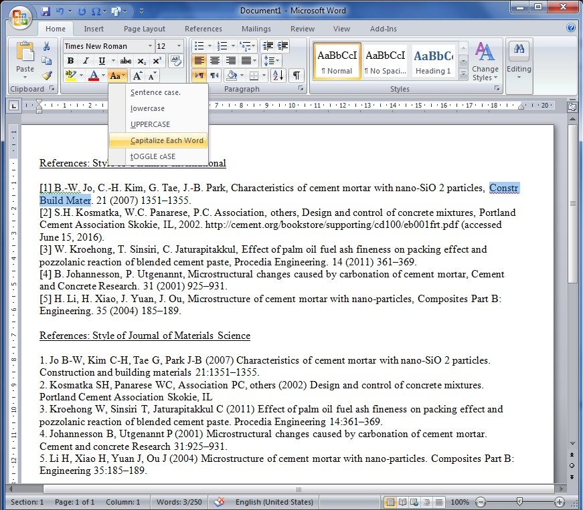
1- Paste on the selected long journal name
2- Apply “Capitalize Each Word” as above
The result is as the selected text above

Slide 36
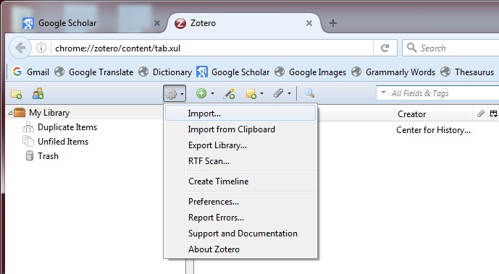
Additional Experience

Slide 37
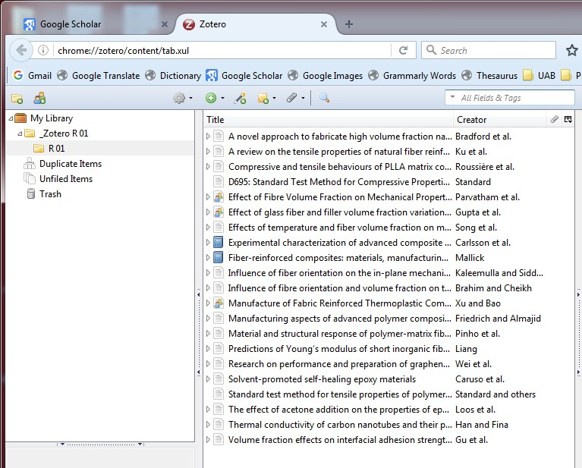
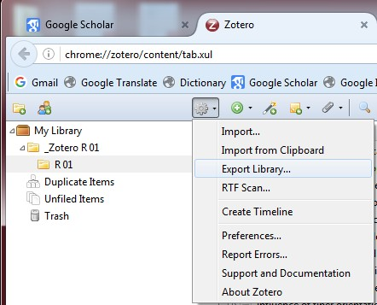

Slide 38
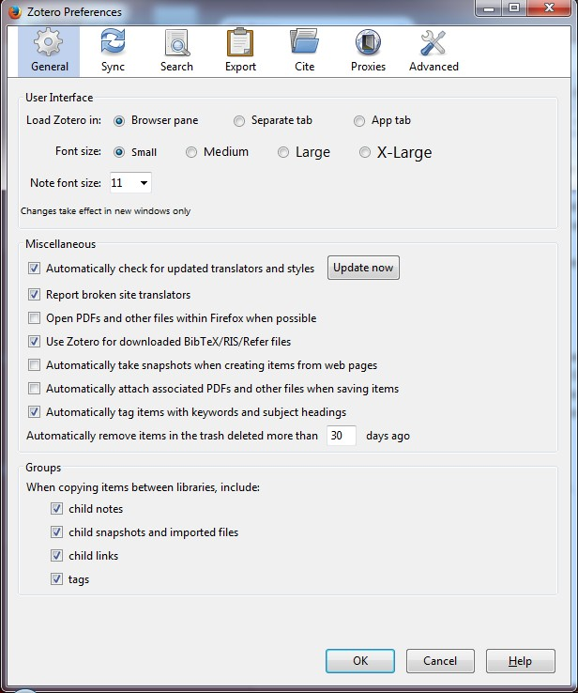
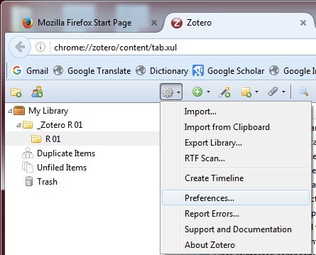

Slide 39
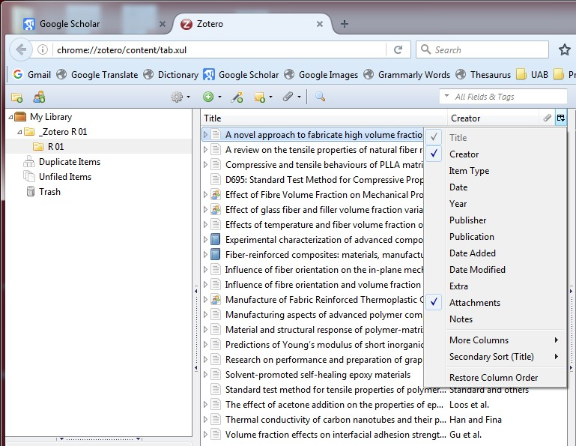

Slide 40
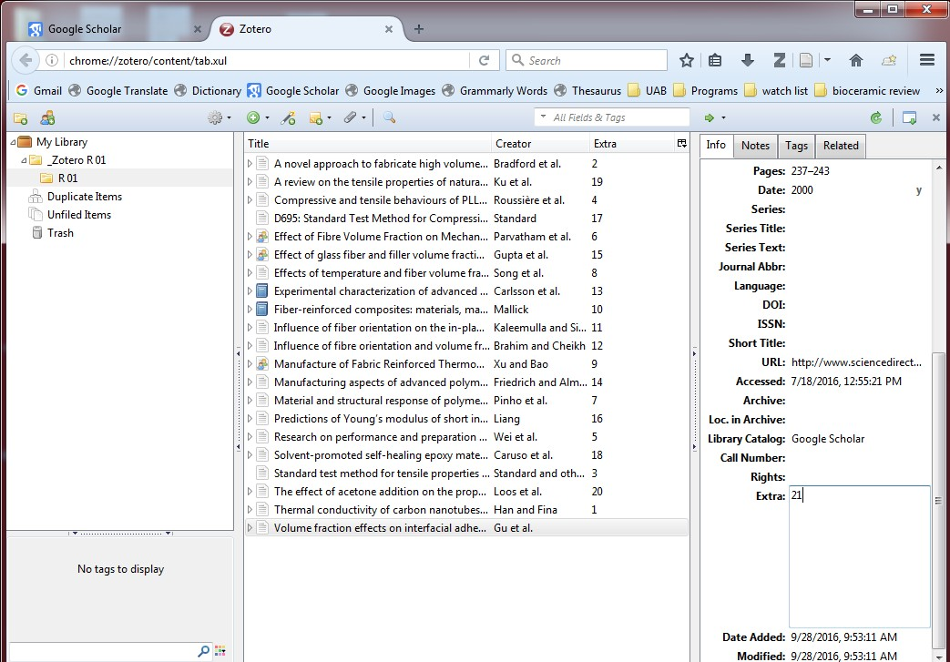

Slide 41
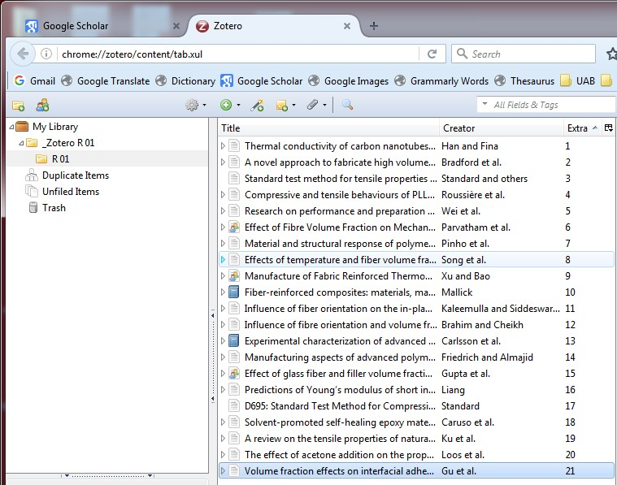
Thank you …

